Slide 1


Wireless Communications
Next-Gen Cellular/WiFi
Smart Homes/Spaces
Autonomous Cars
Smart Cities
Body-Area Networks
Internet of Things
All this and more …

Slide 2
Outline
Wireless History
The Wireless Vision
Technical Challenges
Current/Next-Gen Wireless Systems
Spectrum Regulation and Standards
Emerging Wireless Systems (Optional Lecture)

Slide 3
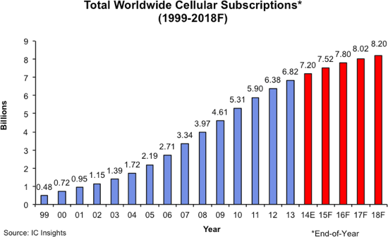
Wireless History
Ancient Systems: Smoke Signals, Carrier Pigeons, …
Radio invented in the 1880s by Marconi
Many sophisticated military radio systems were developed during and after WW2
Exponential growth in cellular use since 1988: approx. 8B worldwide users today
Ignited the wireless revolution
Voice, data, and multimedia ubiquitous
Use in 3rd world countries growing rapidly
Wifi also enjoying tremendous success and growth
Bluetooth pervasive, satellites also widespread

Slide 4
Future Wireless Networks
Ubiquitous Communication Among People and Devices
Next-Gen Cellular/WiFi
Smart Homes/Spaces
Autonomous Cars
Smart Cities
Body-Area Networks
Internet of Things
All this and more …

Slide 5
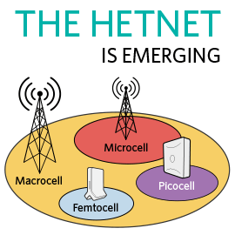



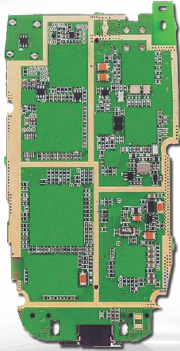
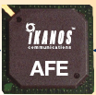
Challenges
Network/Radio Challenges
Gbps data rates with “no” errors
Energy efficiency
Scarce/bifurcated spectrum
Reliability and coverage
Heterogeneous networks
Seamless internetwork handoff
5G
AdHoc
Short-Range
Device/SoC Challenges
Performance
Complexity
Size, Power, Cost
High frequencies/mmWave
Multiple Antennas
Multiradio Integration
Coexistance
BT
Radio
Cellular
GPS
Cog
Mem
WiFi
CPU
mmW

Slide 6
Software-Defined (SD) Radio:
Is this the solution to the device challenges?
BT
FM/XM
A/D
Cellular
GPS
A/D
DVB-H
DSP
Apps
Processor
A/D
WLAN
Media
Processor
Wimax
A/D
Wideband antennas and A/Ds span BW of desired signals
DSP programmed to process desired signal: no specialized HW
Today, this is not cost, size, or power efficient
SubNyquist sampling may help with the A/D and DSP requirements

Slide 7
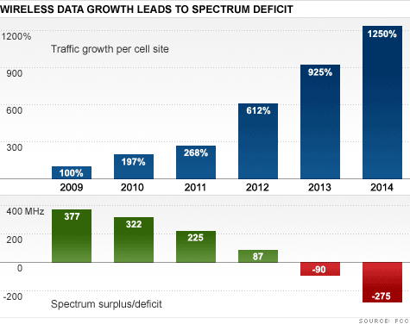
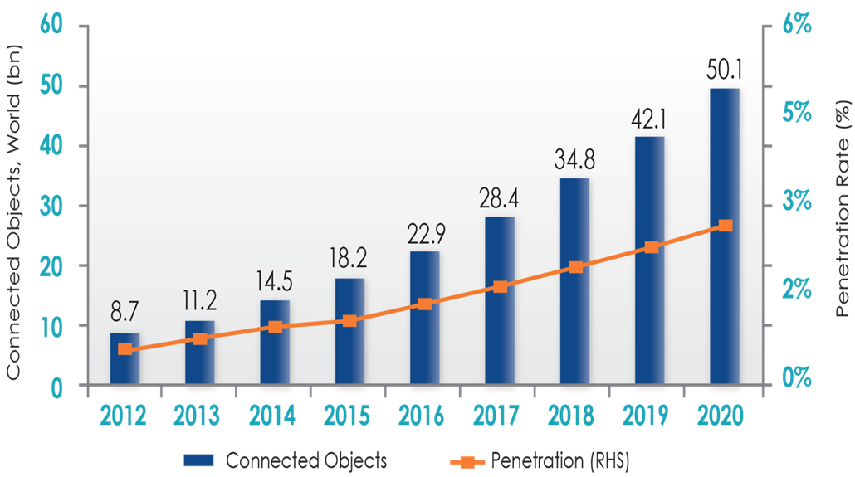
“Sorry America, your airwaves are full*”
On the Horizon:
“The Internet of Things”
Exponential Mobile Data Growth
Leading to massive spectrum deficit
50 billion devices by 2020
Source: FCC
*CNN MoneyTech – Feb. 2012
7

Slide 8
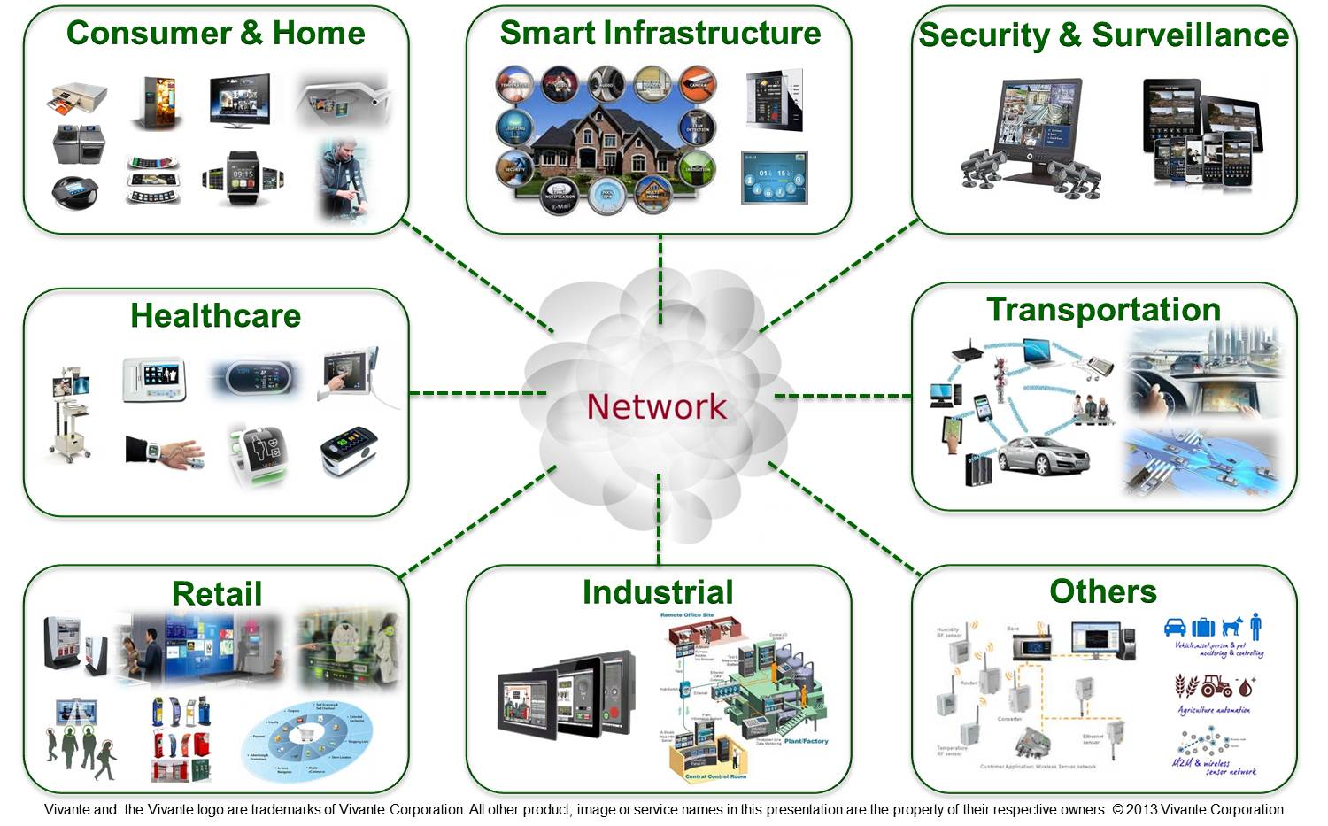
What is the Internet of Things:
Enabling every electronic device to be connected to each other and the Internet
Includes smartphones, consumer electronics, cars, lights, clothes, sensors, medical devices,…
Value in IoT is data processing in the cloud
Different requirements than smartphones: low rates/energy consumption

Slide 9
Are we at the Shannon limit of the Physical Layer?
We are at the Shannon Limit
“The wireless industry has reached the theoretical limit of how fast networks can go” K. Fitcher, Connected Planet
“We’re 99% of the way” to the “barrier known as Shannon’s limit,” D. Warren, GSM Association Sr. Dir. of Tech.
Shannon was wrong, there is no limit
“There is no theoretical maximum to the amount of data that can be carried by a radio channel” M. Gass, 802.11 Wireless Networks: The Definitive Guide
“Effectively unlimited” capacity possible via personal cells (pcells). S. Perlman, Artemis.

Slide 10
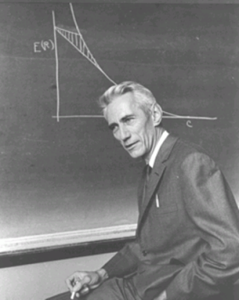
What would Shannon say?
We don’t know the Shannon capacity of most wireless channels
Time-varying channels.
Channels with interference or relays.
Cellular systems
Ad-hoc and sensor networks
Channels with delay/energy/$$$ constraints.
Shannon theory provides design insights
and system performance upper bounds

Slide 11
Current/Next-Gen Wireless Systems
Current:
4G Cellular Systems (LTE-Advanced)
4G Wireless LANs/WiFi (802.11ac)
mmWave massive MIMO systems
Satellite Systems
Bluetooth
Zigbee
WiGig
Emerging
5G Cellular and WiFi Systems
Ad/hoc and Cognitive Radio Networks
Energy-Harvesting Systems
Chemical/Molecular
Much room
For innovation

Slide 12
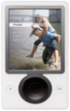
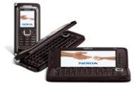
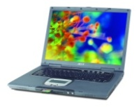
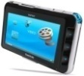
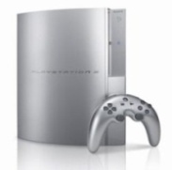

Spectral Reuse
Due to its scarcity, spectrum is reused
In licensed bands
and unlicensed bands
BS
Cellular
Wifi, BT, UWB,…
Reuse introduces interference

Slide 13
Cellular Systems: Reuse channels to maximize capacity
Geographic region divided into cells
Freq./timeslots/codes/space reused in different cells (reuse 1 common).
Interference between cells using same channel: interference mitigation key
Base stations/MTSOs coordinate handoff and control functions
Shrinking cell size increases capacity, as well as complexity, handoff, …
BASE
STATION
MTSO

Slide 14
4G/LTE Cellular
Much higher data rates than 3G (50-100 Mbps)
3G systems has 384 Kbps peak rates
Greater spectral efficiency (bits/s/Hz)
More bandwidth, adaptive OFDM-MIMO, reduced interference
Flexible use of up to 100 MHz of spectrum
10-20 MHz spectrum allocation common
Low packet latency (<5ms).
Reduced cost-per-bit (not clear to customers)
All IP network

Slide 15
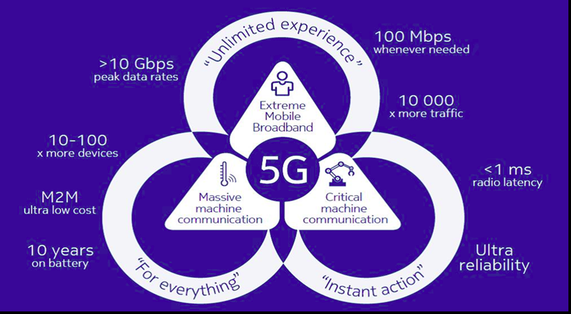
5G Upgrades from 4G

Slide 16
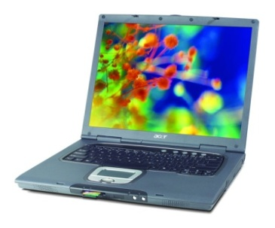
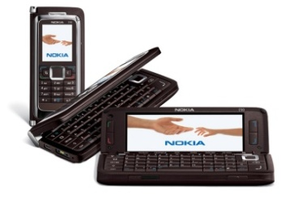

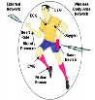
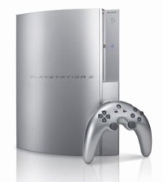
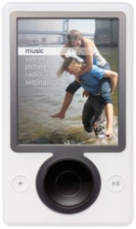
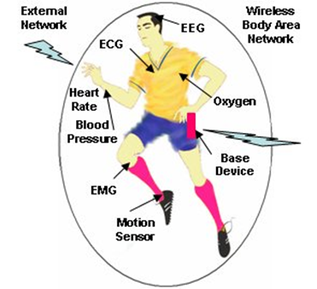
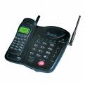
Future Cellular Phones
Burden for this performance is on the backbone network
Everything wireless in one device
San Francisco
BS
BS
LTE backbone is the Internet
Internet
Paris
N^{th}-Gen
Cellular
Phone
System
N^{th}-Gen
Cellular
BS
Much better performance and reliability than today
- Gbps rates, low latency, 99% coverage, energy efficiency

Slide 17
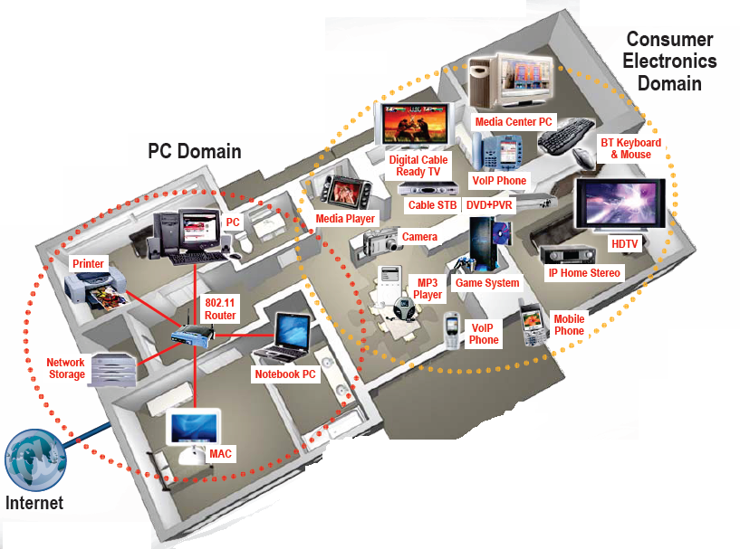
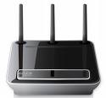

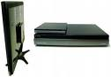
Wifi Networks Multimedia Everywhere, Without Wires
802.11ac
Streaming video
Gbps data rates
High reliability
Coverage inside and out
Wireless HDTV
and Gaming

Slide 18
Wireless LAN Standards
802.11b (Old – 1990s)
Standard for 2.4GHz ISM band (80 MHz)
Direct sequence spread spectrum (DSSS)
Speeds of 11 Mbps, approx. 500 ft range
802.11a/g (Middle Age– mid-late 1990s)
Standard for 5GHz band (300 MHz)/also 2.4GHz
OFDM in 20 MHz with adaptive rate/codes
Speeds of 54 Mbps, approx. 100-200 ft range
802.11n/ac/ax (current/next gen)
Standard in 2.4 GHz and 5 GHz band
Adaptive OFDM /MIMO in 20/40/80/160 MHz
Antennas: 2-4, up to 8
Speeds up to 1 Gbps (10 Gbps for ax), approx. 200 ft range
Other advances in packetization, antenna use, multiuser MIMO
Many
WLAN
cards
have
(a/b/g/n)

Slide 19
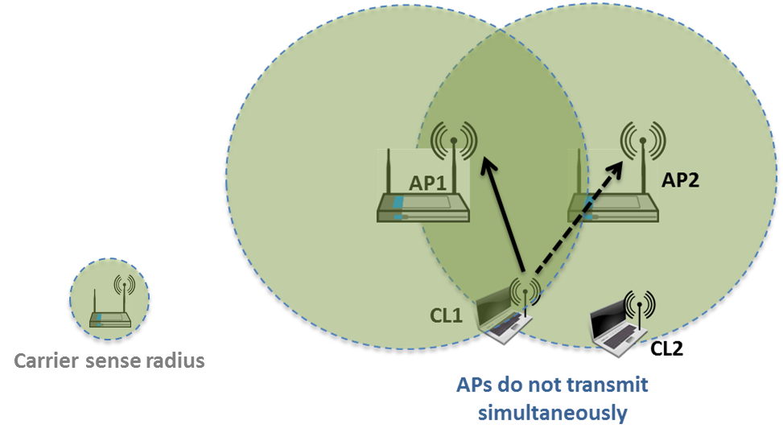
Why does WiFi performance suck?
Carrier Sense Multiple Access:
if another WiFi signal
detected, random backoff
Collision Detection: if collision
detected, resend
The WiFi standard lacks good mechanisms to mitigate interference, especially in dense AP deployments
Multiple access protocol (CSMA/CD) from 1970s
Static channel assignment, power levels, and carrier sensing thresholds
In such deployments WiFi systems exhibit poor spectrum reuse and significant contention among APs and clients
Result is low throughput and a poor user experience
Multiuser MIMO will help each AP, but not interfering APs

Slide 20
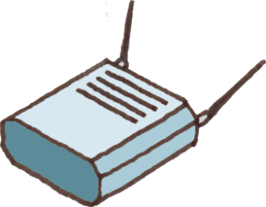
Self-Organizing Networks for WiFi
- Channel Selection
- Power Control
- etc.
SoN
Controller
SoN-for-WiFi: dynamic self-organization network software to manage of WiFi APs.
Allows for capacity/coverage/interference mitigation tradeoffs.
Also provides network analytics and planning.

Slide 21
Satellite Systems
Cover very large areas
Different orbit heights
GEOs (39000 Km) versus LEOs (2000 Km)
Optimized for one-way transmission
Radio (XM, Sirius) and movie (SatTV, DVB/S) broadcasts
Most two-way systems went bankrupt
Global Positioning System (GPS) ubiquitous
Satellite signals used to pinpoint location
Popular in cell phones, PDAs, and navigation devices

Slide 22
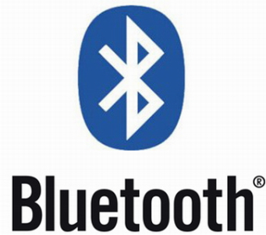
Bluetooth
Cable replacement RF technology (low cost)
Short range (10m, extendable to 100m)
2.4 GHz band (crowded)
1 Data (700 Kbps) and 3 voice channels, up to 3 Mbps
Widely supported by telecommunications, PC, and consumer electronics companies
Few applications beyond cable replacement
8C32810.61-Cimini-7/98

Slide 23
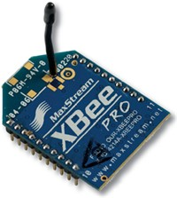
IEEE 802.15.4/ZigBee Radios
Low-rate low-power low-cost secure radio
Complementary to WiFi and Bluetooth
Frequency bands: 784, 868, 915 MHz, 2.4 GHz
Data rates: 20Kbps, 40Kbps, 250 Kbps
Range: 10-100m line-of-sight
Support for large mesh networking or star clusters
Support for low latency devices
CSMA-CA channel access
Applications: light switches, electricity meters, traffic management, and other low-power sensors.

Slide 24
Spectrum Regulation
Spectrum a scarce public resource, hence allocated
Spectral allocation in US controlled by FCC (commercial) or OSM (defense)
FCC auctions spectral blocks for set applications.
Some spectrum set aside for universal use
Worldwide spectrum controlled by ITU-R
Regulation is a necessary evil.
Innovations in regulation being considered worldwide
in multiple cognitive radio paradigms

Slide 25
Standards
Interacting systems require standardization
Companies want their systems adopted as standard
Alternatively try for de-facto standards
Standards determined by TIA/CTIA in US
IEEE standards often adopted
Process fraught with inefficiencies and conflicts
Worldwide standards determined by ITU-T
In Europe, ETSI is equivalent of IEEE
Standards for current systems are summarized in Appendix D.

Slide 26
Emerging Systems
Advanced Topics Lecture
New cellular system architectures
mmWave/massive MIMO communications
Software-defined network architectures
Ad hoc/mesh wireless networks
Cognitive radio networks
Wireless sensor networks
Energy-constrained radios
Distributed control networks
Chemical Communications
Applications of Communications in Health, Bio-medicine, and Neuroscience

Slide 27
Rethinking “Cells” in Cellular
How should cellular
systems be designed for
Capacity
Coverage
Energy efficiency
Low latency
Coop
MIMO
Small
Cell
Relay
DAS
Traditional cellular design “interference-limited”
MIMO/multiuser detection can remove interference
Cooperating BSs form a MIMO array: what is a cell?
Relays change cell shape and boundaries
Distributed antennas move BS towards cell boundary
Small cells create a cell within a cell
Mobile cooperation via relays, virtual MIMO, network coding.

Slide 28

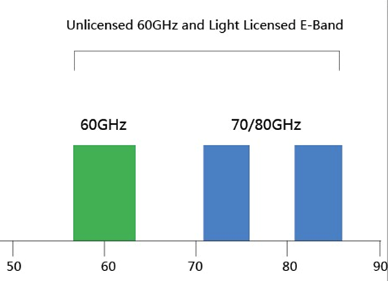

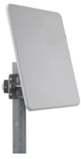
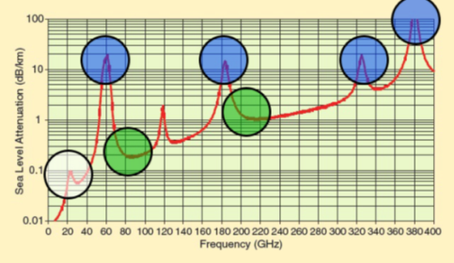
mmWave Massive MIMO
Dozens of devices
⬅10s of GHz of Spectrum➔
Hundreds
of antennas
mmWaves have large non-monotonic path loss
Channel model poorly understood
For asymptotically large arrays with channel state information, no attenuation, fading, interference or noise
mmWave antennas are small: perfect for massive MIMO
Bottlenecks: channel estimation and system complexity
Non-coherent design holds significant promise

Slide 29

Software-Defined Network Architectures
App layer
Cloud Computing
Video
Security
Vehicular
Networks
M2M
Health
Freq.
Allocation
Power
Control
Self
Healing
ICIC
QoS
Opt.
CS
Threshold
Network Optimization
UNIFIED CONTROL PLANE
HW layer
Distributed Antennas
WiFi
Cellular
mmWave
…
Ad-Hoc
Networks

Slide 30
Ad-Hoc Networks
Peer-to-peer communications
No backbone infrastructure or centralized control
Routing can be multihop.
Topology is dynamic.
Fully connected with different link SINRs
Open questions
Fundamental capacity region
Resource allocation (power, rate, spectrum, etc.)
Routing
Notes:
-No backbone: nodes must self-configure into a network.
-In principle all nodes can communicate with all other nodes, but multihop routing can reduce the interference associated with direct transmission.
-Topology dynamic since nodes move around and link characteristics change.
-Applications: appliances and entertainment units in the home, community networks that bypass the Internet. Military networks for robust flexible easily-deployed network (every soldier is a node).

Slide 31
Cognitive Radios
I_{P}
CRTx
CRRx
NCR
NCR
CR
CR
NCRTx
NCRRx
MIMO Cognitive Underlay
Cognitive Overlay
Cognitive radios support new users in existing crowded spectrum without degrading licensed users
Utilize advanced communication and DSP techniques
Coupled with novel spectrum allocation policies
Multiple paradigms
(MIMO) Underlay (interference below a threshold)
Interweave finds/uses unused time/freq/space slots
Overlay (overhears/relays primary message while cancelling interference it causes to cognitive receiver)

Slide 32
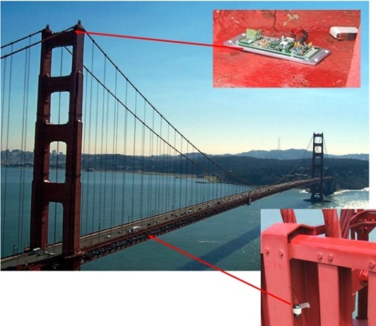
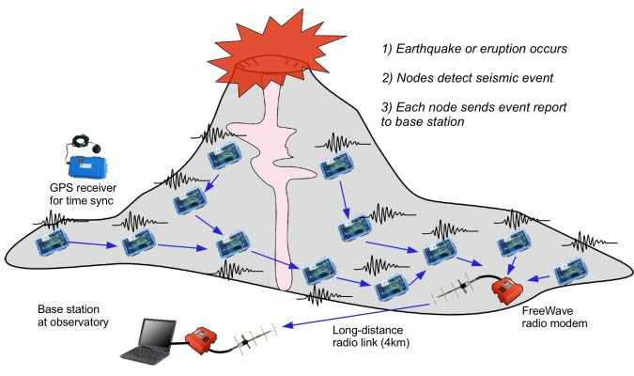
Wireless Sensor Networks
Data Collection and Distributed Control
Smart homes/buildings
Smart structures
Search and rescue
Homeland security
Event detection
Battlefield surveillance
Energy (transmit and processing) is the driving constraint
Data flows to centralized location (joint compression)
Low per-node rates but tens to thousands of nodes
Intelligence is in the network rather than in the devices

Slide 33
Energy-Constrained Radios
Transmit energy minimized by sending bits slowly
Leads to increased circuit energy consumption
Short-range networks must consider both transmit and processing/circuit energy.
Sophisticated encoding/decoding not always energy-efficient.
MIMO techniques not necessarily energy-efficient
Long transmission times not necessarily optimal
Multihop routing not necessarily optimal
Sub-Nyquist sampling can decrease energy and is sometimes optimal!
Notes:
All the sophisticated high-performance communication techniques developed since WW2 may need to be thrown out the window.
By cooperating, nodes can save energy

Slide 34

Where should energy come from?
Batteries and traditional charging mechanisms
Well-understood devices and systems
Wireless-power transfer
Poorly understood, especially at large distances and with high efficiency
Communication with Energy Harvesting Radios
Intermittent and random energy arrivals
Communication becomes energy-dependent
Can combine information and energy transmission
New principles for radio and network design needed.

Slide 35

Distributed Control over Wireless
Automated Vehicles
- Cars
- Airplanes/UAVs
- Insect flyers
Interdisciplinary design approach
Control requires fast, accurate, and reliable feedback.
Wireless networks introduce delay and loss
Need reliable networks and robust controllers
Mostly open problems
: Many design challenges

Slide 36
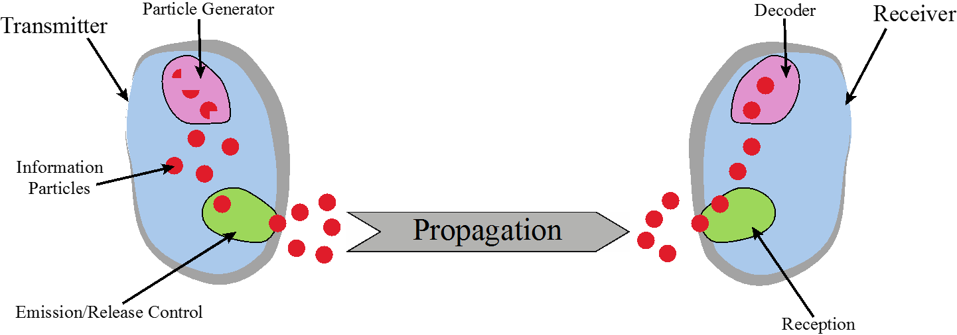
Chemical Communications
Can be developed for both macro (>cm) and micro (<mm) scale communications
Greenfield area of research:
Need new modulation schemes, channel impairment mitigation, multiple acces, etc.

Slide 37


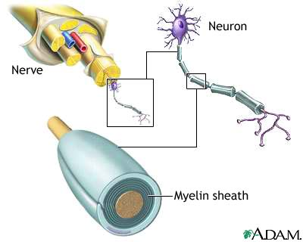

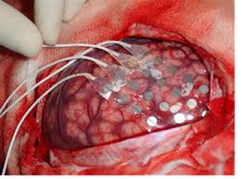
Applications in Health, Biomedicine and Neuroscience
Neuroscience
Nerve network (re)configuration
EEG/ECoG signal processing
Signal processing/control for deep brain stimulation
SP/Comm applied to bioscience
Body-Area
Networks
Recovery from Nerve Damage
ECoG Epileptic Seizure Localization
EEG
ECoG

Slide 38
Main Points
The wireless vision encompasses many exciting applications
Technical challenges transcend all system design layers
5G networks must support higher performance for some users, extreme energy efficiency and/or low latency for others
Cloud-based software to dynamically control and optimize wireless networks needed (SDWN)
Innovative wireless design needed for 5G cellular/WiFi, mmWave systems, massive MIMO, and IoT connectivity
Standards and spectral allocation heavily impact the evolution of wireless technology

